Slide 1
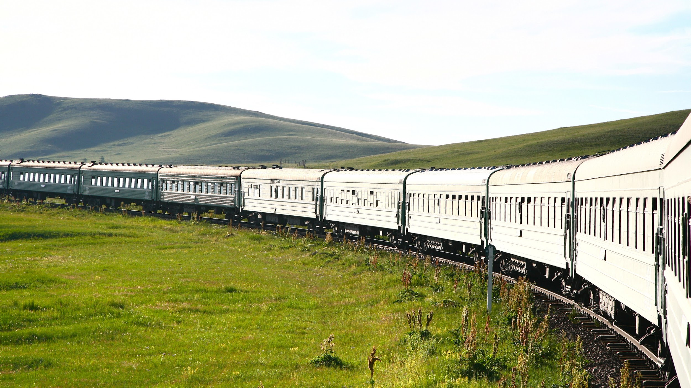
E-TICKET SYSTEM
FOR TRAIN
MSSQL DATABASE PROJECT BY,
Mohammed Mustafa [H22011],
Neha Nandakishor Zade [H22012],
Shrutika Ramdas Bhimanpalli [H22015],
Gireesh AV [H22006]

Slide 2
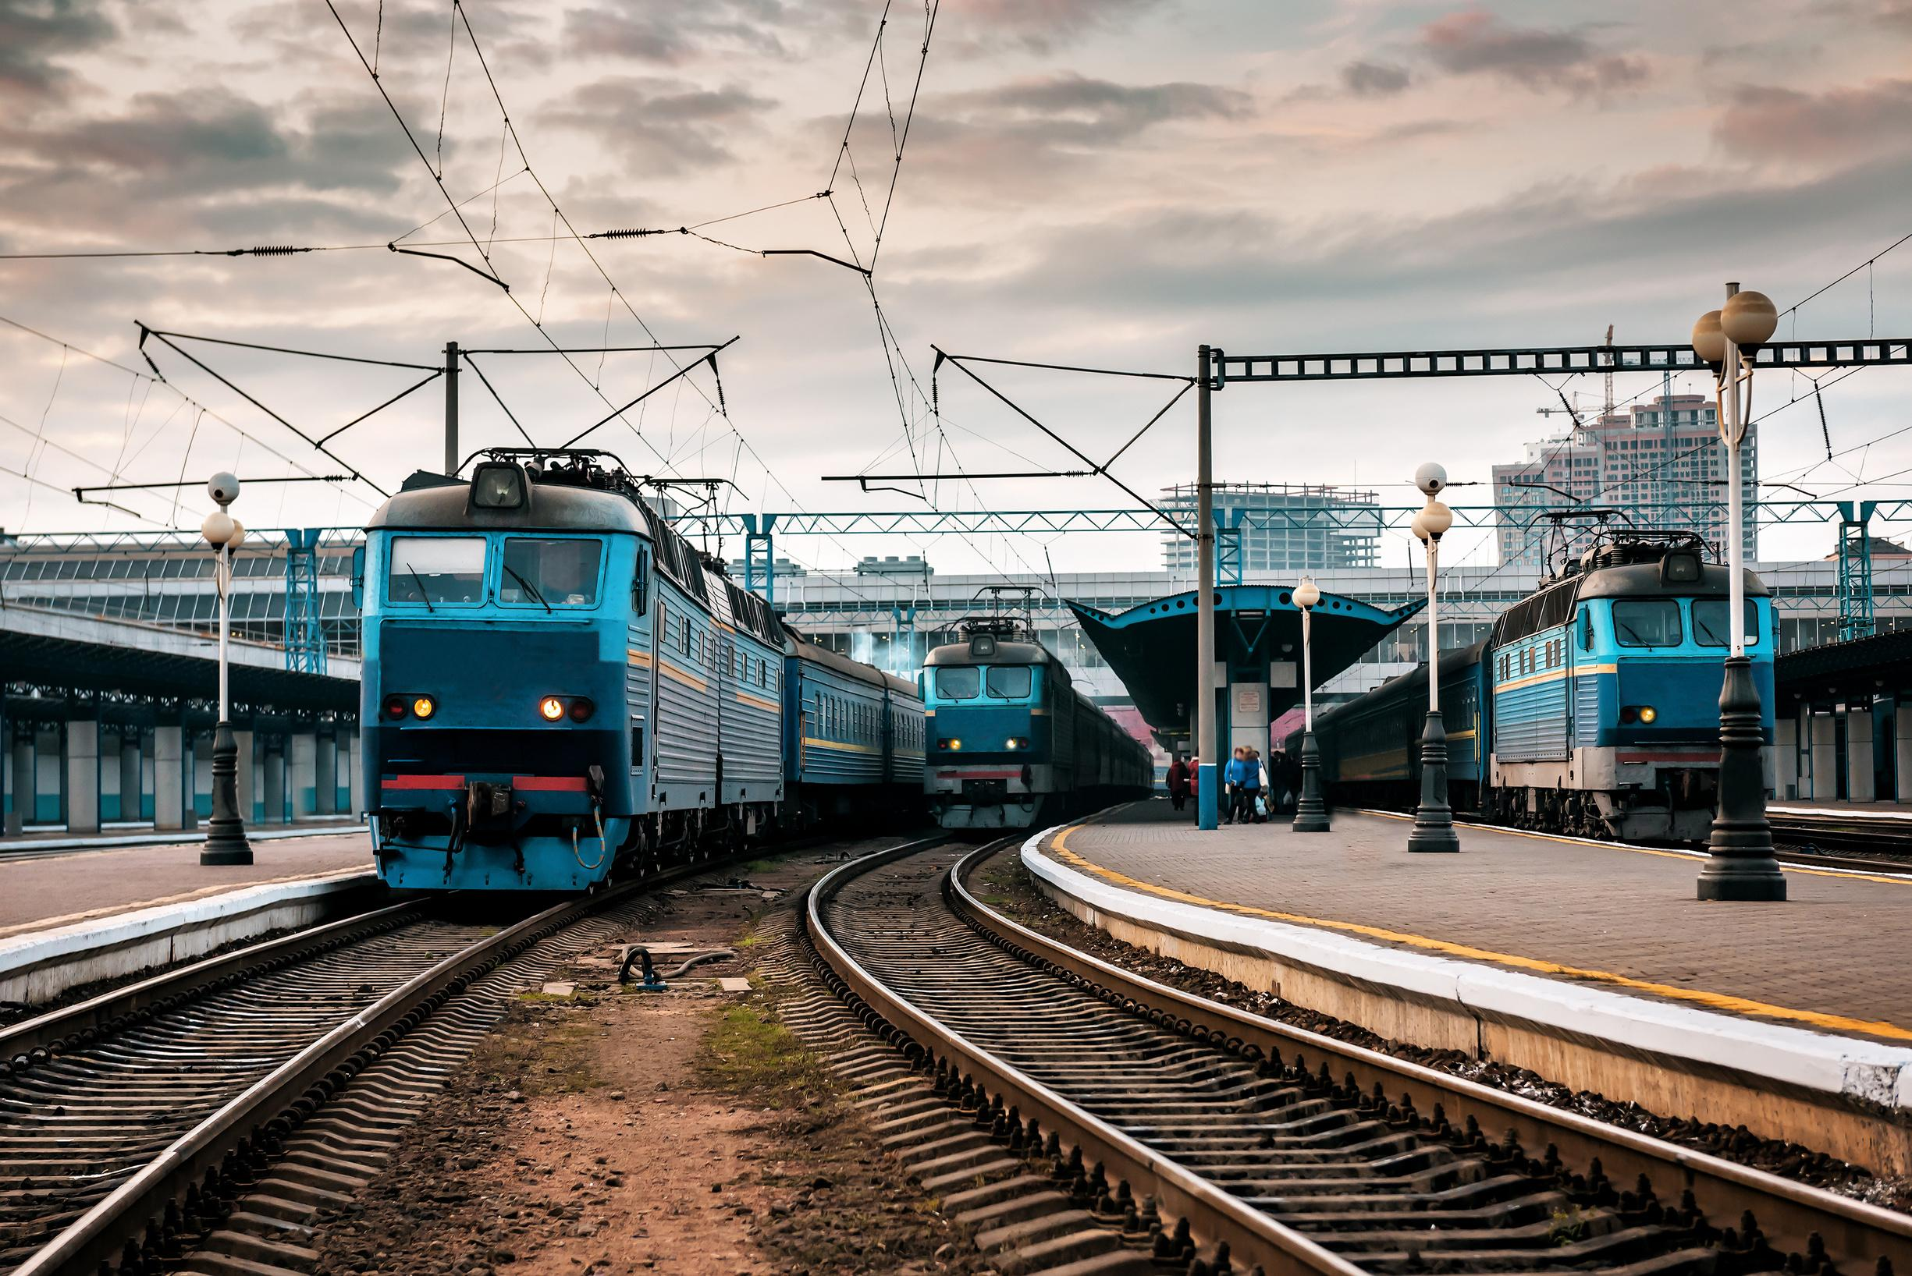
INTRODUCTION
The Indian Railways (IR) carries about 5.5 lakhs passengers in reserved accommodation every day. The number of the reservation counters available to the passengers and customers are very less. On most of the reservation systems, there are long queues, so it takes a long time for any individual to book the ticket. As now there are no call centers facilities available to solve the queries of the passengers. So with our system we can solve the issue. These tickets can be booked or cancelled for journeys commencing in any part of India and ending in any other part, with registration id. It also facilitates the passengers to enquiry about the trains available on the basis of source and destination, enquiry about the status of the booked ticket (PNR Status). With the help of online booking, people can book their tickets online through internet sitting in their home by a single click. Using their credit cards/debit cards/online payments, people can easily get their tickets done within minutes.

Slide 3
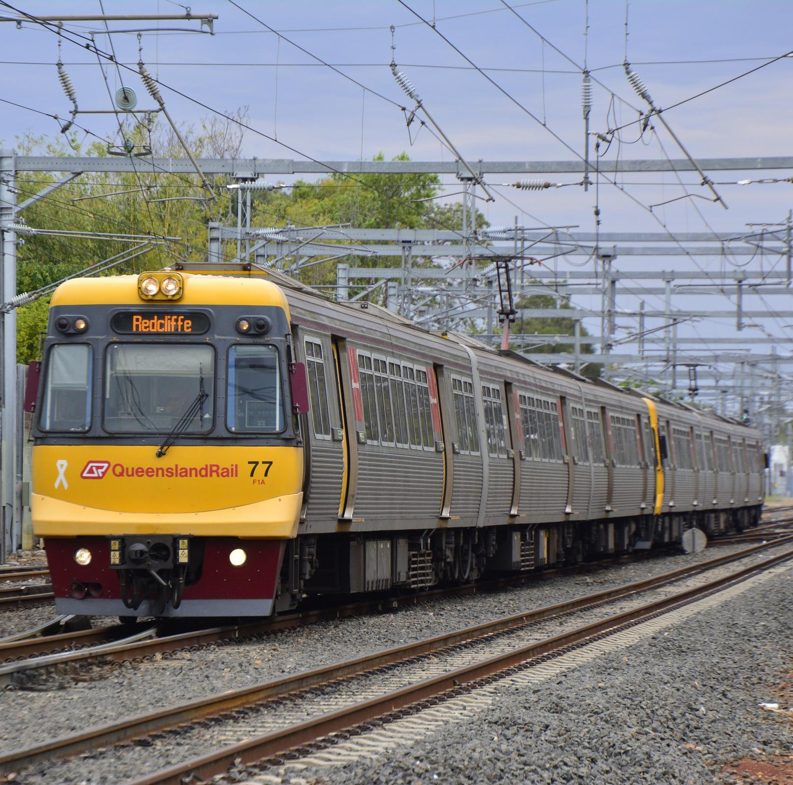
SCOPE
Users will be able to search the train availability ,the exact fare , the arrival and departure time of the train and they can also book their ticket by using the system's online payment method and each user has a wallet linked to it for booking purpose and after booking the ticket if the user wants to cancel it then they can easily do it.
The Administration will be able to store data about all the trains that are available for commute between various stations and data about seating charts. We can also get all the route details about a particular train through this system.
Also in case of cancellation the seats are automatically updated and also the money will be added to wallet at the same time just by using cancel procedure.
We can also get information about passengers and check if their seats are confirmed or not.

Slide 4
USER
ROLES
CITY
PERMISSION
It contains details of the user who wants to book the ticket.
This table will specify what all roles will be given to the user ( like admin,passenger,etc.)
This table specifies the details of the city for boarding or departure of train and has a link to the state table. (Ex: Chennai)
This table will specify what all permissions will be given to the user based on what they logged in with like admin will have access to changing train data but passengers will not be able to do it.
STATE
TRAIN
TABLES
This table specifies the details of the state for boarding or departure of train and has a link to the country table. (Ex: Tamil nadu, Maharashtra)
This table contains all the details about the train that the passenger will be traveling with like source , destination, train name etc. which will be helpful for travelers to catch the correct train.
QUOTA
This table is used to store information about the quota for booking of the train ticket like users can book tickets in general quota or ladies quota.
STATION
This table has station related data and which station is located in which city.
ROUTE
COUNTRY
This table will contain information about the number of seats that are in the waiting state of the train.
This table specifies the route that the train will be taking and how many stops that it will take in between source and destination.
This table specifies the details of the country for boarding or departure of train. (Ex: India)
WAITING SEATS

Slide 5
PRICE
REFUND
PNR
RESERVATION
This table has mapping of price for various quota/class and is linked to the train table.
Sole purpose of this table is to store refund status of the user who wants to cancel the ticket and get the refund.
This table will contain all the reservation related details like PNR no etc which will help users to confirm that the booking for ticket has been done and ticket is allocated to the user. Also it has various other details like train no and timings.
This table has pnr no and using which we can get the status of the ticket like it is booked or is in the waiting list.
FEEDBACK
CLASS
PASSENGER CONTACT INFORMATION
TABLES
This table will have feedback about the train. The feedback will be taken from the user.
This table is used to store information about the class in which the passenger wants to book the ticket like A - ac , C - class, E - economy (1A, 2A, 3A, SL, AC Chair (CC), 2S, FC, 3E.
This table will be used for storing passenger’s personal data like mobile no and email id which can be used for contacting them in case of any announcement.
WALLET
This table holds data for the amount that the user has in its account and this amount will get reduced or added in case of cancellation to book another ticket.
TRANSACTION
This table tells us how the transaction for the ticket booking was done, what method was used like upi or credit card and the status of payment whether it is completed or not.
CANCELLATION
This table will have personal details about the passenger like their age,gender and the seat allocated to that certain passenger. Passenger’s alloted birth type like lower or upper will also be mentioned in this table.
This table will hold data for the cancellation requests for the user and will see if they want a refund or want to book another ticket with that money.
PASSENGER

Slide 6
TRAVEL INSURANCE
OFFERS
DRIVER
GOODS
This table holds data about the insurance money paid for travel through train while doing the reservation.
This table will store data about various offers that the registered user can get and till what time will the offer be valid within the end date.
This table contains all the details of the train's driver like his name, what is the wage that they will receive and how many days they worked on which train etc.
This table will have details about the goods if any passenger wants to send it via train and what will be the cost of it.
SHIFT
PLATFORM
TABLES
CONTRACT
This table has a mapping of shift that they will receive like if it is morning shift with a particular period of time.
This table will have mapping of which train will be arriving or departing at which platform in the station.
SALARY
This table will have details about the contractor who is working in the pantry and its contact details.
This table will give the status of salary whether it is credited to the driver or staff with last_credited date.
STAFFS
PANTRY
This table basically stores data related to the vendors who are using trains for promoting their product and will say for how much duration will it be showing it ad and what will be the amount for the same.
This table maps various staff members according to the station that they work on and which shift they will be working for that particular station.
This table will have a mapping of the pantry with the train and which contractor is providing the food.
AD

Slide 7
SOURCE DATE AND TIME OF THE TRAIN
SOURCE STATION
DESTINATION STATION
DESTINATION DATE AND TIME OF THE TRAIN
This table has data relating to timing at which the train will be arriving at the source station .
This table has a list of all source stations with their particular train.
This table has a list of all destination stations with their particular train.
This table has data relating to timing at which the train will be arriving at the destination station .
AVAILABLE SEATS
BOOKED SEATS
TABLES
VENDOR
This table will contain information about the number of seats that are in the available state of the train.
This table will contain information about the number of seats that are in the booked state of the train.
This table will have details about the vendor like his name, age etc who is providing the ads for the train.

Slide 8
USER
ROLES
CITY
PERMISSION
user_id, role_id, name, email, password, dob, gender, mobile, city_id, security_qn, security_ans, wallet_id
role_id, role_name, permission_id
city_id, city_name, state_id
permission_id, permission_name, access
STATE
TRAIN
ATTRIBUTES
QUOTA
STATION
state_id, state_name, country_id
train_no, train_name, train_type
quota_id, quota_name
station_id, station_name, city_id
ROUTE
COUNTRY
train_no, route_id, time, stop_number, station_id, date
WAITING SEATS
train_no, class_id, quota_id, datetime, waiting_seats
country_id, country_name

Slide 9
PRICE
REFUND
PNR
RESERVATION
train_no, class_id, quota_id, price_id, amount
cancellation_id, refund_id, transaction_id, refund_initiated_date
reservation_id, user_id, train_no, class_id, quota_id, arrival_station_id, departure_station_id, arrival_datetime, departure_datetime,amount, transaction_id, PNR_no, insurance_id,offer_id
PNR_no, status
FEEDBACK
CLASS
PASSENGER CONTACT INFORMATION
ATTRIBUTES
reservation_id, user_id, feedback_id, feedback
class_id, class_name [A - ac , C - class, E - economy (1A, 2A, 3A, SL, AC Chair (CC), 2S, FC, 3E )]
reservation _id, passenger_id, name, age, gender, seat_no, birth preference
WALLET
wallet_id, amount
TRANSACTION
CANCELLATION
transaction_id, amount, payment_type, payment_status
reservation _id, passenger_id, name, age, gender, seat_no, birth preference
user_id, reservation_id, cancellation_id, type (Refund / book another ticket)
PASSENGER

Slide 10
TRAVEL INSURANCE
OFFERS
DRIVER
GOODS
insurance_amount, insurance_id, insurance_name
offer_id, offer_name, description, end_date, amount
train_no, driver_name, driver_id, shift_id, no_of_days_worked, salary_id
.train_no,goods_id,source_route_id,destination_route_id, type, price
SHIFT
PLATFORM
ATTRIBUTES
CONTRACT
shift_id, start_time, end_time
train_no, station_id, platform_no, date and time
SALARY
contract_id, person_name, phone_number
salary_id, last_credited, transaction_id, salary
STAFFS
PANTRY
staff_id, staff_name, shift_id, station_id, salary_id, duty
ad_id, ad_name, description, start_datetime, end_datetime, transaction_id, price, vendor_id
train_no, pantry_no, contract_id
AD

Slide 11
SOURCE DATE AND TIME OF THE TRAIN
SOURCE STATION
DESTINATION STATION
DESTINATION DATE AND TIME OF THE TRAIN
time_id,source_station_id,train_no, source_date and time
train_no, destination_station_id
time_id,destination_station_id,train_no, destination_date and time
train_no, source_station_id
AVAILABLE SEATS
BOOKED SEATS
ATTRIBUTES
VENDOR
train_no, class_id, quota_id, datetime, available_seats
train_no, class_id, quota_id, datetime, booked_seats
vendor_id, name, dob, phone_no, email

Slide 12
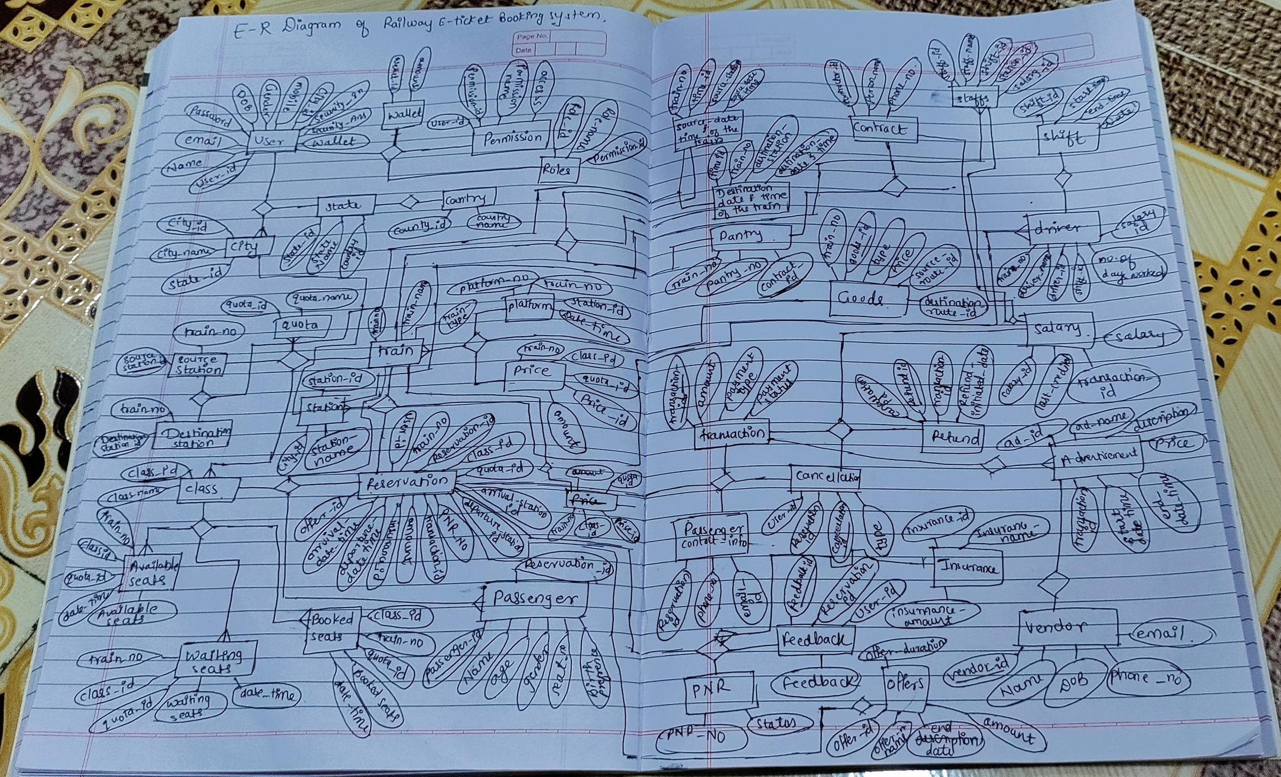
ER DIAGRAM

Slide 13
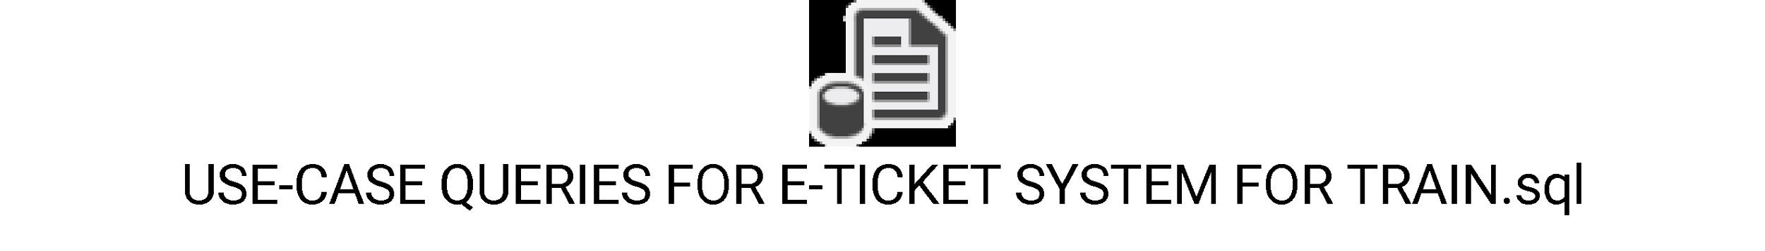
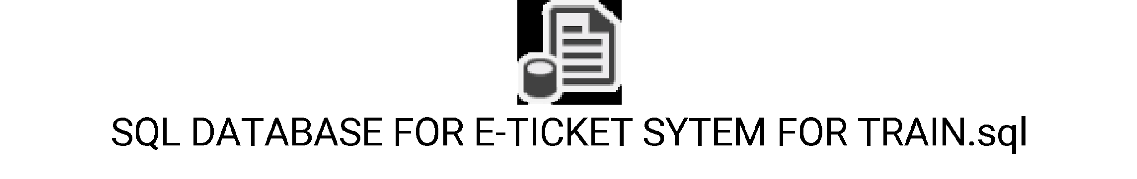
DEPLOYEMENT FILE

Slide 14

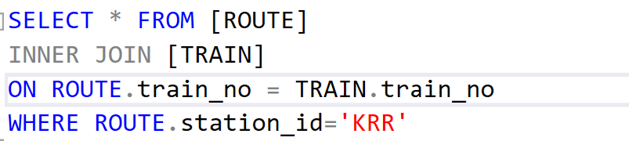
USE-CASES 1
TO READ THE DETAILS OF THE TRAIN OF A PARTICULAR STATION.

Slide 15
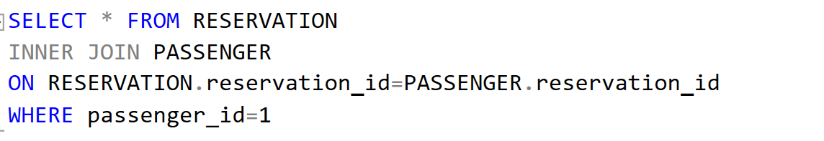
USE-CASES 2
TO READ THE RESERVATION DETAILS OF A PARTICULAR PASSENGER.

Slide 16
USE-CASES 3
TO READ THE DRIVER, SALARY AND SHIFT DETAILS OF THE TRAIN DRIVER.

Slide 17
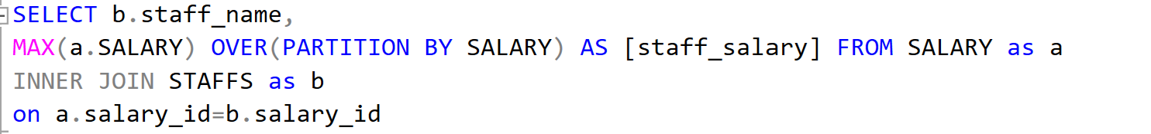
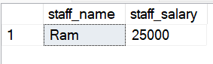
USE-CASES 4
TO READ THE NAME AND SALARY OF STAFFS WHO GET MAXIMUM SALARY.

Slide 18
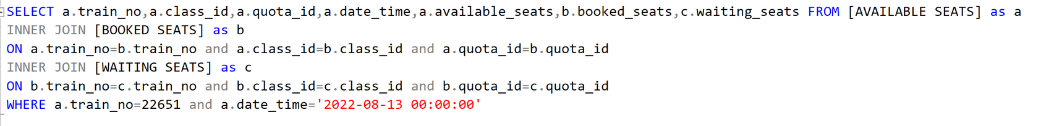
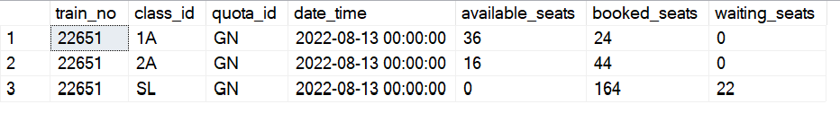
USE-CASES 5
TO READ THE NUMBER OF SEATS AVAILABLE, WAITING AND BOOKED OF A PARTICULAR TRAIN NUMBER AND DATE, TIME WITH THEIR CLASS AND QUOTA.

Slide 19
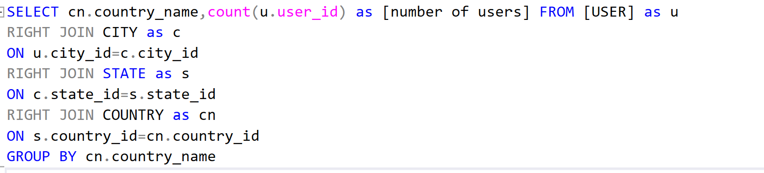
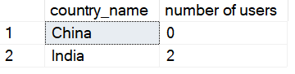
USE-CASES 6
TO READ THE NUMBER OF USERS WITH THEIR COUNTRY.

Slide 20
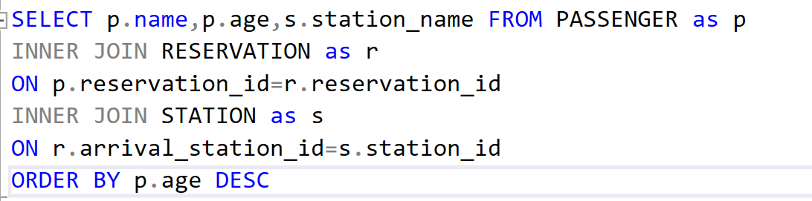
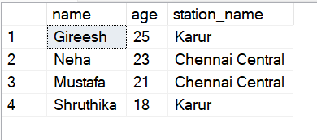
USE-CASES 7
TO READ THE LIST OF PASSENGERS WITH THEIR RESERVATION OF ARRIVAL STATION NAME BY DESCENDING ORDER OF AGE.

Slide 21
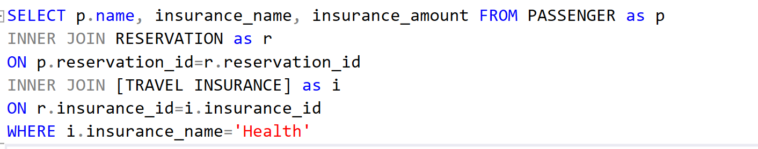
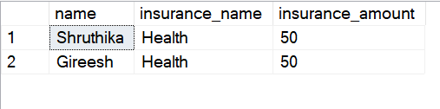
USE-CASES 8
TO READ THE PASSENGERS WHO HAVE MADE HEALTH INSURANCE.

Slide 22
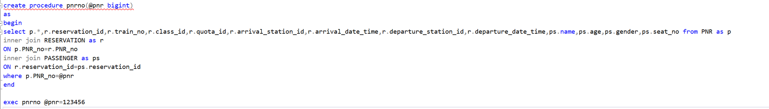
USE-CASES 9
TO READ THE DETAILS OF THE RESERVATION USING PNR NO.

Slide 23
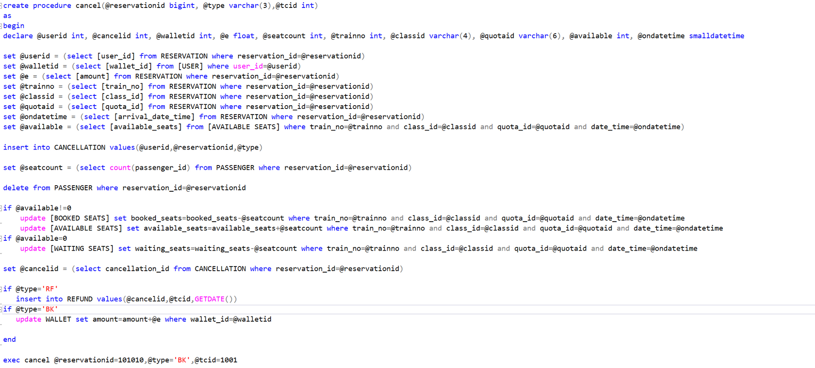
USE-CASES 10
TO MAKE A CANCELLATION, INSERT DATA TO REFUND OR WALLET BASED ON THE CANCELLATION TYPE, UPDATE SEATS OF THAT PARTICULAR TRAIN ON THAT RESERVATION DATE AND TIME.

Slide 24
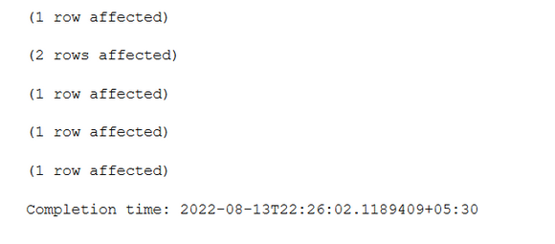
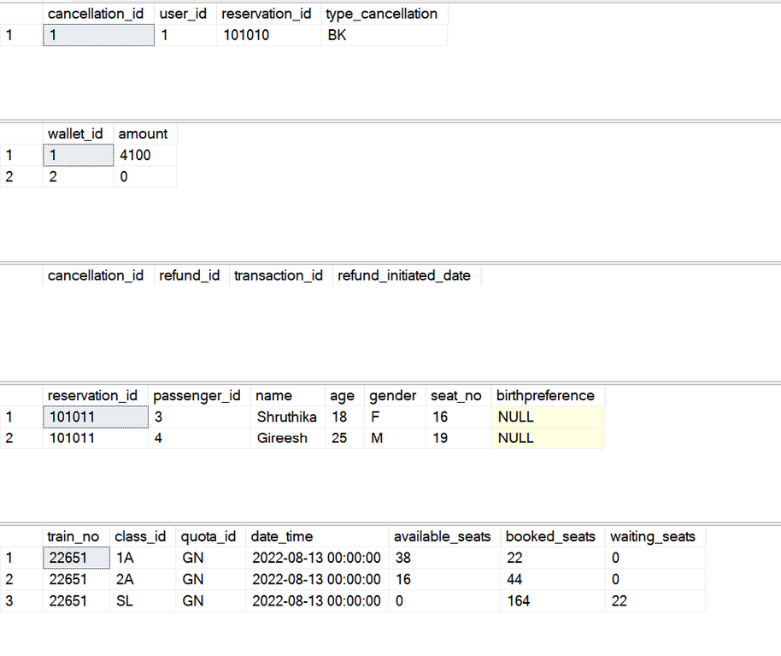
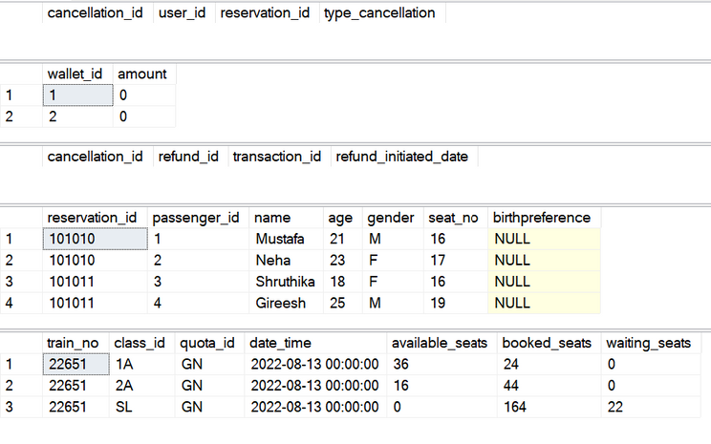
USE-CASES 10
AFTER
BEFORE

Slide 25
PRAXIS-PGPDE
THANK
YOU!
Let us know if you have questions or clarifications.
BY SQL GROUP-6

